Slide 1






Process Mapping Overview
Visualizing Workflows for Efficiency and Clarity

Slide 2
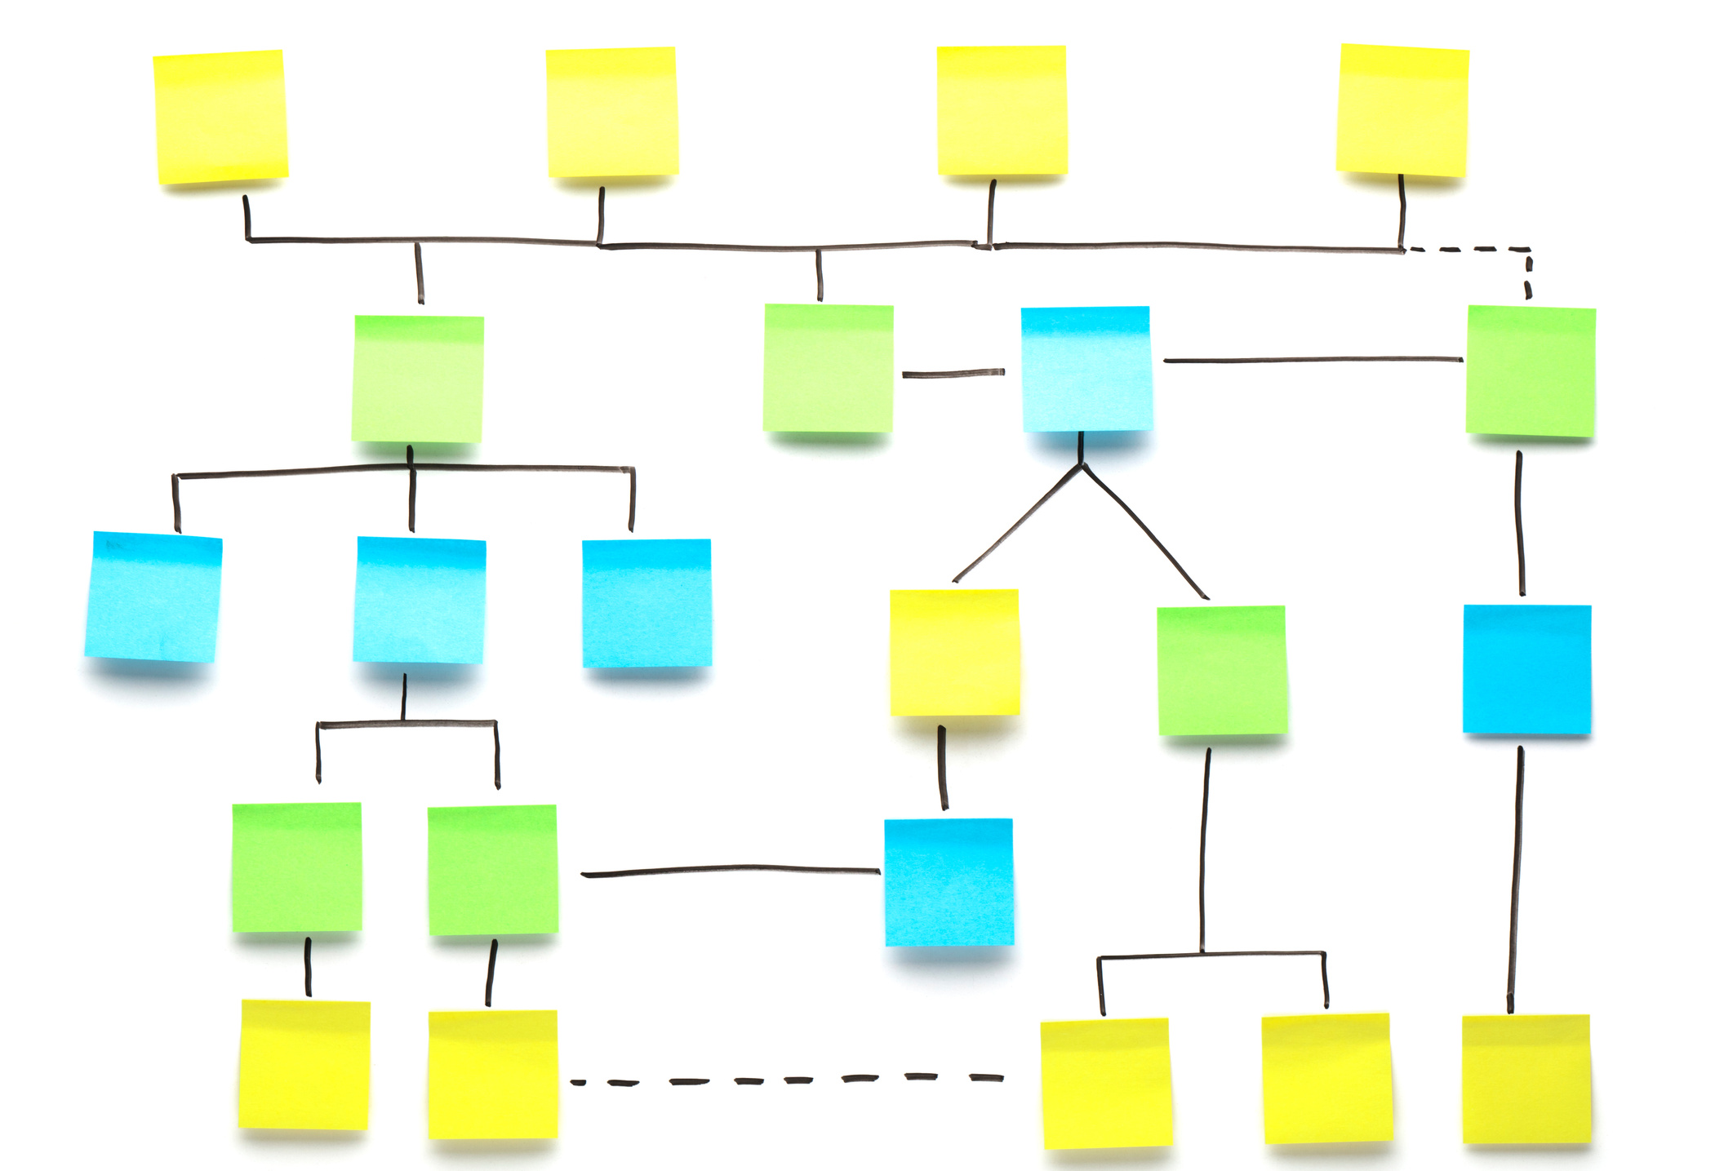


What is PROCESS MAPPING?
  Definition: Process mapping is a visual representation of workflows, showing how tasks, decisions, and responsibilities move through a system.
  Purpose: To analyze, understand, and improve processes.
Notes:
"To begin, what exactly is process mapping? Simply put, it is a visual representation of workflows that outlines how tasks, decisions, and responsibilities move through a system. The goal is to analyze, understand, and improve processes. The example I shared with you last month is a good example of how straightforward yet impactful process mapping can be."

Slide 3


Unlocking Process Mapping Benefits
Enhanced Team Communication
Increased Operational Efficiency
Better Regulatory Compliance
Continuous Process Improvement
Improves clarity and reduces misunderstandings
Ensures adherence to necessary standards
Streamlines workflows and saves time
Drives ongoing enhancements and innovation
Notes:
"Now let’s talk about the benefits of process mapping. First, it brings clarity by making complex processes easier to understand. It boosts efficiency by identifying bottlenecks and redundancies. It ensures standardization across teams, fostering consistency. Additionally, it encourages collaboration by engaging stakeholders and helps in meeting regulatory and quality standards. The icons here represent these key benefits at a glance."

Slide 4

Key Components of a process map
Start/End Points: Define process boundaries.
Tasks/Steps: Represented by rectangles.
Decision Points: Represented by diamonds.
Arrows: Show the flow of tasks.
Roles/Actors: Who performs each step.
Notes:
"Next, let’s talk about the components of a process map. Every map has start and end points to define its boundaries. Tasks or steps are represented by rectangles, while decision points use diamonds. Arrows illustrate the flow of tasks, and roles or actors show who is responsible for each step. The diagram here highlights these elements, making it easier to follow the flow."

Slide 5


Steps to create a process map
□ Define Objectives: Understand the purpose of mapping.
□ Gather Information: Interview stakeholders and observe workflows.
□ Outline Steps: List all tasks, decisions, and inputs.
□ Choose a Format: Select the appropriate type of process map.
□ Draw the Map: Use software or pen and paper.
□ Validate: Review with stakeholders for accuracy.
□ Analyze and Improve: Identify areas for optimization.
Notes:
"Creating a process map involves several steps. First, define your objectives—what are you hoping to achieve? Next, gather information by interviewing stakeholders and observing workflows. Outline the steps, listing all tasks, decisions, and inputs. Choose a format that suits your needs, then draw the map using software or simple tools. Validate the map by reviewing it with stakeholders, and finally, analyze it to identify areas for improvement. This checklist will guide you through the process effectively."

Slide 6

Common Pitfalls to avoid
  Overcomplicating the Map: Stick to key details.
  Lack of Collaboration: Involve all relevant stakeholders.
  Skipping Validation: Ensure accuracy with reviews.
  Ignoring Updates: Regularly update maps as processes evolve.
Notes:
"While process mapping can be transformative, there are some common pitfalls to watch out for. Avoid overcomplicating the map by focusing only on key details. Lack of collaboration can lead to incomplete maps, so involve all relevant stakeholders. Don’t skip validation—it’s essential for accuracy. And finally, remember to update your maps regularly to keep up with process changes.

Slide 7

  Process mapping is essential for understanding and improving workflows.
  It supports efficiency, collaboration, and consistency.
  Regular updates and stakeholder involvement are crucial.
Key Takaways
Notes:
"To conclude, process mapping is an essential tool for understanding and improving workflows. It drives efficiency, collaboration, and consistency while keeping processes aligned with organizational goals. Remember, regular updates and stakeholder involvement are crucial for success.

Slide 8


LET’S TALK
Share your thoughts or ask questions
Notes:
"Now it’s your turn! Let’s discuss any questions you have or share your thoughts on process mapping. I’m excited to hear your insights and ideas."

